Slide 1
Construction Safety Unit IV Assignment – Struck-By Hazards
Student Name:
Date:
Instructions:
Each of the following slides contains a construction site photo that depicts one or more struck-by hazards.
Examine each photo and answer the questions in the notes section of each slide. Make sure to also move the red arrow (provided in the bottom left corner of each slide) to point toward the location of the hazard.
Save the completed presentation and upload it into Blackboard.
Be sure to put your name at the top of this first slide!

Slide 2
Figure 1
(Occupational Safety & Health Administration [OSHA], 2003.)
Notes:
Identify and describe the struck-by hazard in this photo. Move and place the red arrow over the photo to indicate the locations of the hazard.
What OSHA construction standard(s) could be cited?
What would you recommend to correct the hazard?

Slide 3
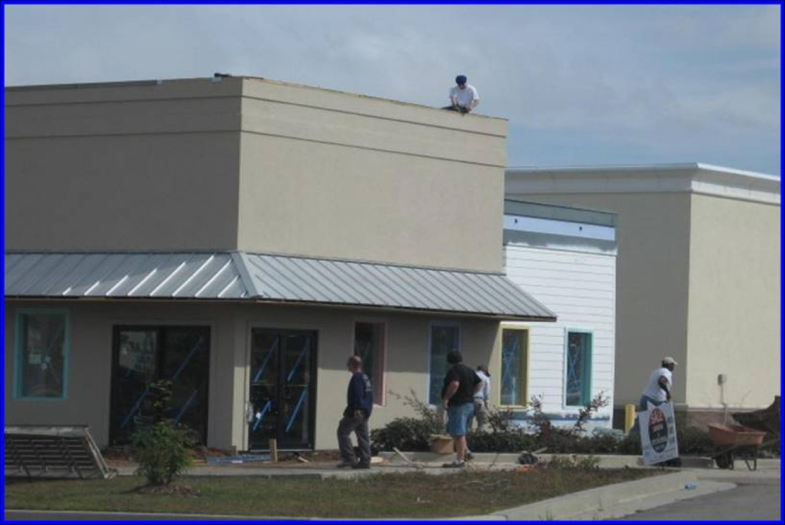
Figure 2
(OSHA, n.d.-a.)
Notes:
Identify and describe the struck-by hazard in this photo. Move and place the red arrow over the photo to indicate the locations of the hazard.
What OSHA construction standard(s) could be cited?
What would you recommend to correct the hazard?

Slide 4
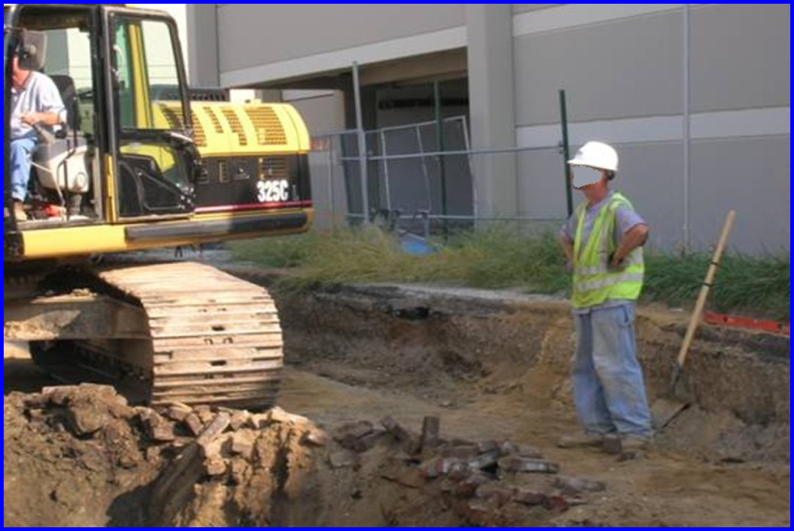
Figure 3
(OSHA, n.d.-b)
Notes:
Identify and describe the struck-by hazard in this photo. Move and place the red arrow over the photo to indicate the locations of the hazard.
What OSHA construction standard(s) could be cited?
What would you recommend to correct the hazard?

Slide 5
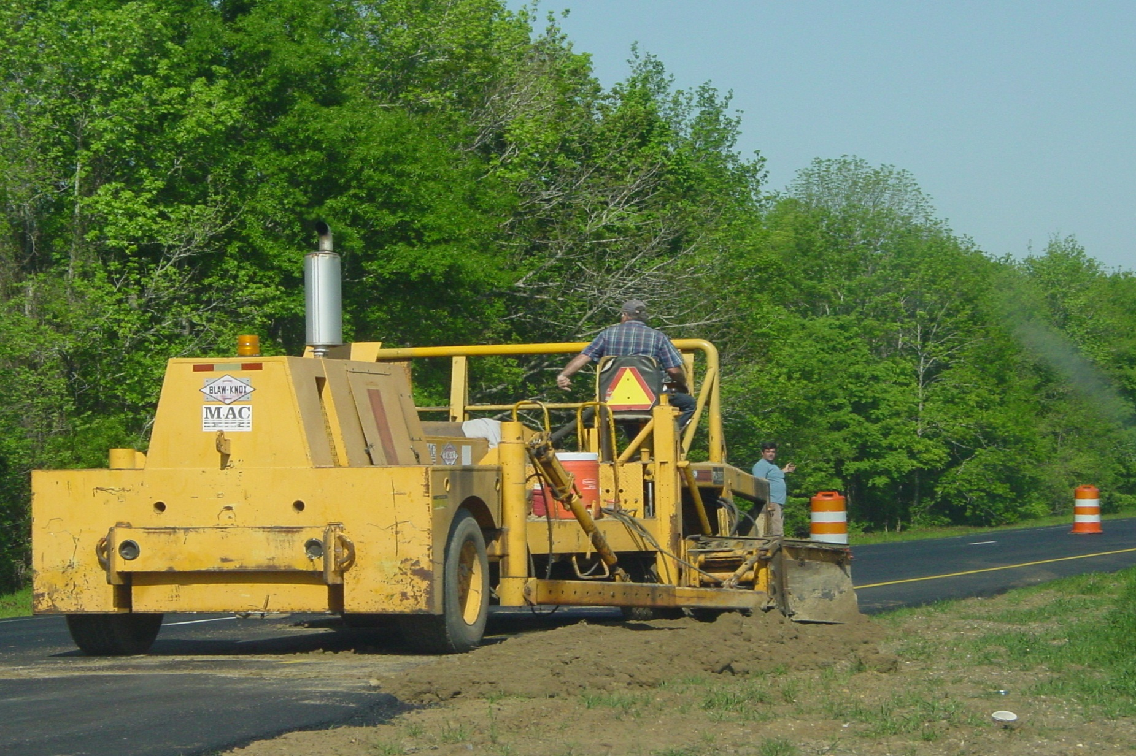
Figure 4
(OSHA, n.d.-c)
Notes:
Identify and describe the struck-by hazard in this photo. Move and place the red arrow over the photo to indicate the locations of the hazard.
What OSHA construction standard(s) could be cited?
What would you recommend to correct the hazard(s)?

Slide 6
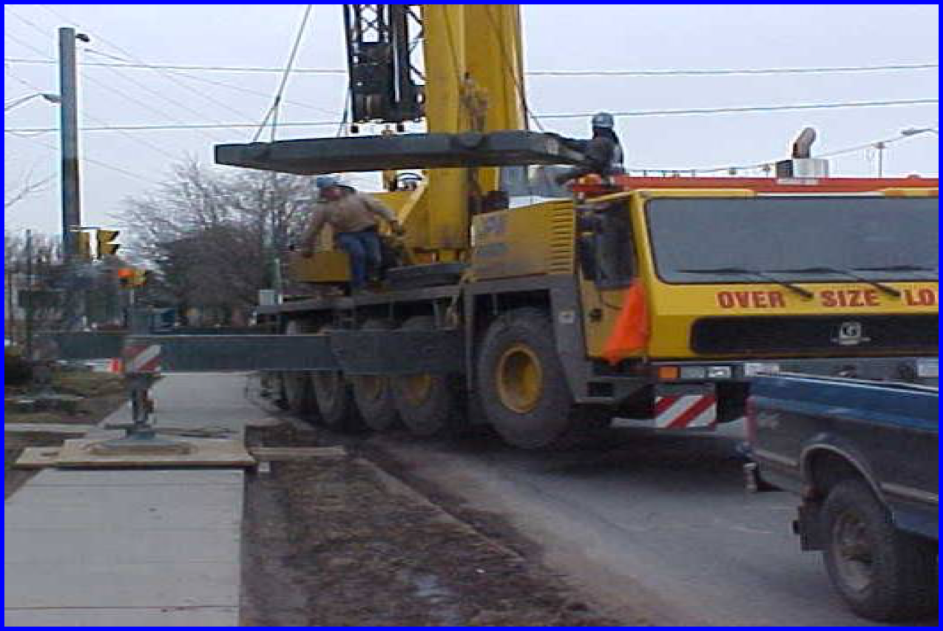
Figure 5
(OSHA, n.d.-d)
Notes:
Identify and describe the struck-by hazard in this photo. Move and place the red arrow over the photo to indicate the locations of the hazard.
What OSHA construction standard(s) could be cited?
What would you recommend to correct the hazard(s)?

Slide 7
References
Occupational Safety & Health Administration. (n.d.-a). Figure 2 [Image]. From Struck-By Hazard Recognition [PowerPoint presentation]. Retrieved from https://www.osha.gov/dte/outreach/construction/focus_four/struckby/struckby_hazrec.ppt
Occupational Safety & Health Administration. (n.d.-b). Figure 3 [Image]. From Struck-By Hazard Recognition [PowerPoint presentation]. Retrieved from https://www.osha.gov/dte/outreach/construction/focus_four/struckby/struckby_hazrec.ppt
Occupational Safety & Health Administration. (n.d.-c). Figure 4 [Image]. From Struck-By Hazard Recognition [PowerPoint presentation]. Retrieved from https://www.osha.gov/dte/outreach/construction/focus_four/struckby/struckby_hazrec.ppt
Occupational Safety & Health Administration. (n.d.-d). Figure 5 [Image]. From Struck-By Hazard Recognition [PowerPoint presentation]. Retrieved from https://www.osha.gov/dte/outreach/construction/focus_four/struckby/struckby_hazrec.ppt
Occupational Safety & Health Administration. (2003). Figure 1 [Image]. Retrieved from http://www.msabc.net/safety%20programs/osha%20poto%20archive/html/machine_guarding_pg1.html

